Slide 1
Apache Spark

Slide 2
What is Spark?
Apache Spark™ is a multi-language engine for executing data engineering, data science, and machine learning on single-node machines or clusters.
It provides in-memory computation, making it much faster than Hadoop MapReduce for iterative workloads.
Supports batch processing, streaming, machine learning, and graph processing in a single framework.
Provides APIs for Scala, Java, Python (PySpark), and R (SparkR), making it flexible for developers.
Uses RDDs (Resilient Distributed Datasets) for fault-tolerant, parallel data processing.

Slide 3
Apache Spark
Apache Spark is an open-source distributed computing system used for big data workloads that provides an interface for programming entire clusters with implicit data parallelism and fault tolerance.
It utilizes in-memory caching and optimized query execution for fast analytic queries against data of any size.
Its primary purpose is to handle the real-time generated data.
While it's often associated with Hadoop due to its compatibility and ability to run on Hadoop clusters, Spark is a separate project under the Apache Software Foundation.
Apache Spark is designed for speed and ease of use, offering APIs in languages such as Scala, Java, Python, and R.
It provides high-level APIs for programming in batch processing, streaming, machine learning, and interactive SQL-like queries, making it a versatile tool for various data processing tasks.

Slide 4
Spark was built on the top of the Hadoop MapReduce.
It was optimized to run in memory whereas alternative approaches like Hadoop's MapReduce writes data to and from computer hard drives.
So, Spark process the data much quicker than other alternatives.

Slide 5
Key features of Apache Spark
Speed: Spark achieves high performance through in-memory computing and efficient data processing. It can perform batch processing tasks up to 100 times faster than Hadoop MapReduce due to its ability to cache data in memory.
Ease of Use: Spark offers high-level APIs in multiple languages, making it accessible to a wide range of users, including data engineers, data scientists, and developers. It also provides a unified engine for batch processing, interactive queries, streaming, and machine learning.
Versatility: Spark supports a variety of data processing workloads, including batch processing (using the Spark Core API), interactive SQL-like queries (using Spark SQL), real-time streaming data processing (using Spark Streaming), and machine learning (using MLlib).
Fault Tolerance: Spark provides fault tolerance through resilient distributed datasets (RDDs), which are immutable distributed collections of objects. RDDs automatically recover from node failures, ensuring reliable data processing.
Integration with Hadoop: Spark can run on Hadoop clusters, accessing data stored in Hadoop Distributed File System (HDFS), HBase, Cassandra, and other data sources. It can also leverage Hadoop's YARN resource manager for cluster resource management.

Slide 6
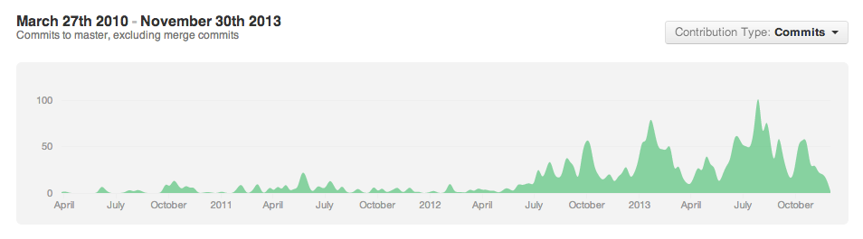

















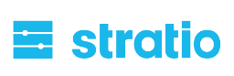









The Spark Community
Notes:
One of the most exciting things you’ll find
Growing all the time
NASCAR slide
Including several sponsors of this event are just starting to get involved…
If your logo is not up here, forgive us – it’s hard to keep up!

Slide 7
Use cases of Spark
Real-time fraud detection (using Spark Streaming)
Big data analytics on logs (using Spark SQL)
Machine learning on large datasets (using MLlib)
Graph-based social network analysis (using GraphX)

Slide 8
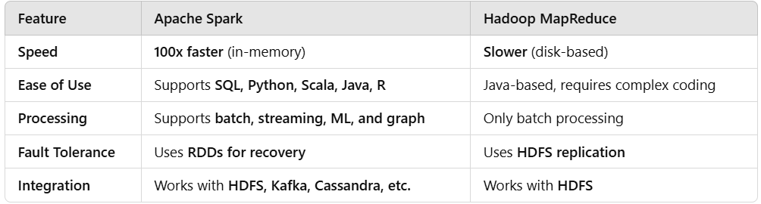
Difference with MapReduce

Slide 9
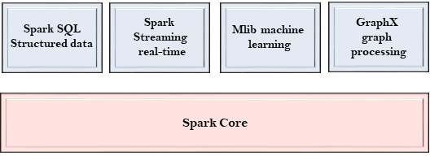
Spark Components
The Spark project consists of different types of tightly integrated components.
At its core, Spark is a computational engine that can schedule, distribute and monitor multiple applications.

Slide 10
Spark Core
The Spark Core is the heart of Spark and performs the core functionality.
It holds the components for task scheduling, fault recovery, interacting with storage systems and memory management.

Slide 11
Spark SQL
The Spark SQL is built on the top of Spark Core. It provides support for structured data.
It allows to query the data via SQL (Structured Query Language) as well as the Apache Hive variant of SQL.
It supports JDBC and ODBC connections that establish a relation between Java objects and existing databases, data warehouses and business intelligence tools.
It also supports various sources of data like Hive tables, Parquet, and JSON.

Slide 12
Spark Streaming
Spark Streaming is a Spark component that supports scalable and fault-tolerant processing of streaming data.
It uses Spark Core's fast scheduling capability to perform streaming analytics.
It accepts data in mini-batches and performs RDD transformations on that data.
The log files generated by web servers can be considered as a real-time example of a data stream.

Slide 13
MLlib
The MLlib is a Machine Learning library that contains various machine learning algorithms.
These include correlations and hypothesis testing, classification and regression, clustering, and principal component analysis.
It is nine times faster than the disk-based implementation used by Apache Mahout.

Slide 14
GraphX
The GraphX is a library that is used to manipulate graphs and perform graph-parallel computations.
It facilitates to create a directed graph with arbitrary properties attached to each vertex and edge.
To manipulate graph, it supports various fundamental operators like subgraph, join Vertices, and aggregate Messages.

Slide 15
Spark’s Python and Scala shells
Apache Spark provides interactive shells for both Python (PySpark) and Scala (Spark shell), allowing users to interactively explore and manipulate data using Spark APIs. These shells provide a convenient environment for prototyping, testing code snippets, and performing ad-hoc data analysis.
Both PySpark and Spark shell offer similar capabilities for interacting with Spark, but they use different programming languages (Python and Scala, respectively). Users can choose the shell based on their language preference and familiarity with Python or Scala. Additionally, both shells provide access to the SparkContext, allowing users to connect to a Spark cluster and execute operations on distributed datasets.

Slide 16
PySpark (Python shell)
PySpark is the Python API for Apache Spark, allowing users to interact with Spark using Python.
To start PySpark, you can simply run the pyspark command in the terminal. This launches the PySpark interactive shell, where you can type Python code and interact with Spark.
PySpark provides full access to Spark's functionality, including RDDs, DataFrames, Spark SQL, MLlib (machine learning library), and Spark Streaming.
PySpark is particularly popular among data scientists and Python developers due to Python's widespread adoption and its ease of use for data analysis and machine learning tasks.

Slide 17
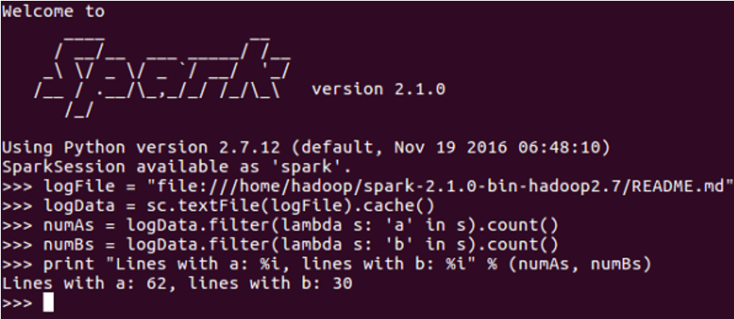
PySpark Shell

Slide 18
Spark shell (Scala shell)
The Spark shell is the interactive shell for Spark's Scala API, allowing users to write and execute Spark applications using Scala.
To start the Spark shell, you can run the spark-shell command in the terminal. This launches the Scala REPL (Read-Eval-Print Loop) with Spark pre-configured, allowing you to write Scala code and interact with Spark.
The Spark shell provides access to all of Spark's features, including RDDs, DataFrames, Spark SQL, MLlib, and Spark Streaming, using Scala syntax.
Scala is the native language of Spark, and the Spark shell provides a powerful environment for writing complex Spark applications and leveraging Scala's features and libraries.

Slide 19
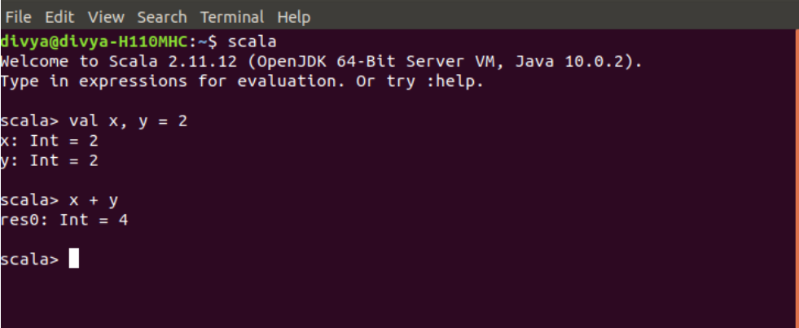
Scala Shell

